Slide 1
BIA Final Project
Sales Analysis For Zomato

Slide 2
Title : Restaurant Sales Analysis for Zomato
Objective
To analyze the sales trends
To identify key performance indicators(KPIs)
To provide actionable insights to improve sales strategies
To provide recommendations on the business plan

Slide 3
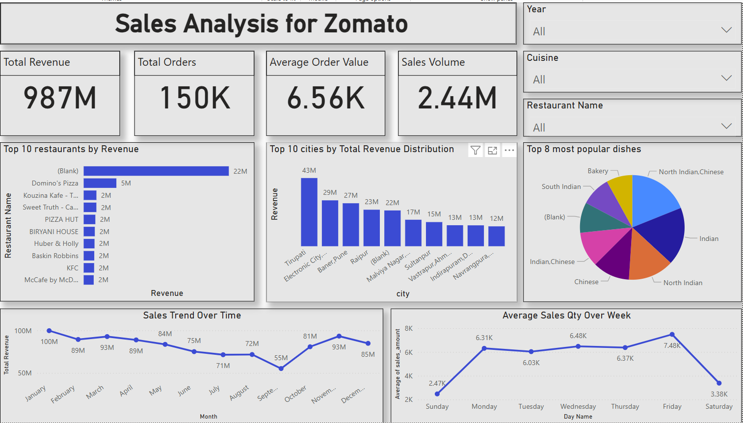

Slide 4
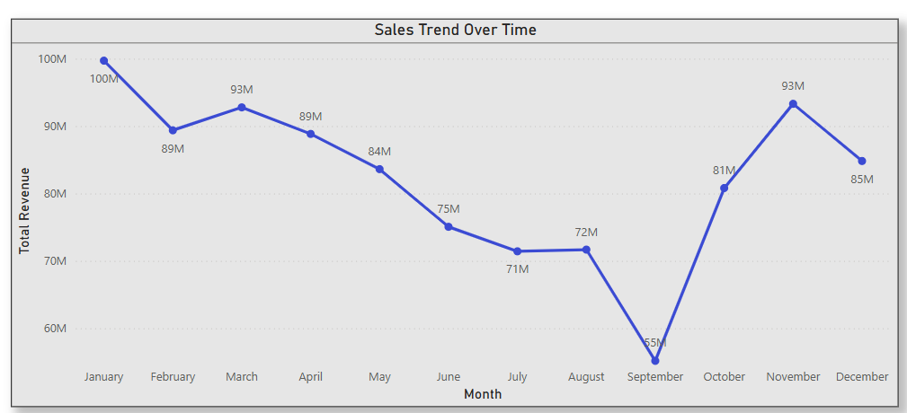
Sales Trends Over Time(Monthly Analysis)
Key Insights
Strong Start in Q1:
January recorded the highest revenue at $100M. Although sales dipped in February ($89M), they slightly recovered in March ($93M).
Consistent Decline in Spring & Summer:
A downward trend from April ($89M) to July ($71M) indicates weakening momentum in mid-year.
Lowest Sales in September:
Revenue hit the lowest point at $55M, suggesting possible seasonality, reduced promotions, or operational gaps.
Q4 Recovery:
A sharp rebound occurred in October ($81M) and November ($93M), likely driven by festive season sales and marketing efforts.
Moderate Dip in December:
Sales declined to $85M, still relatively high, but slightly lower than the Q4 peak in November.

Slide 5
Sales Trends Over Time(Monthly Analysis)
Recommendations
Analyze September Decline:
Investigate factors behind the sharp drop—such as market trends, customer disengagement, or campaign gaps—and address root causes.
Boost Mid-Year Engagement:
Launch targeted promotions and campaigns from May to July to prevent sustained decline during these months.
Capitalize on Q4 Momentum:
Strengthen October–November campaigns with advanced planning, holiday bundles, and optimized ad spend.
Encourage Year-End Purchases:
Introduce loyalty perks or new-year incentives in December to maintain customer interest and avoid post-peak drop-offs.
Plan with Forecasting:
Align inventory, staffing, and marketing resources based on historical performance trends for better operational efficiency.
Targeted Customer Strategies:
Segment customers by purchase seasonality and tailor offers to re-engage off-season buyers.

Slide 6
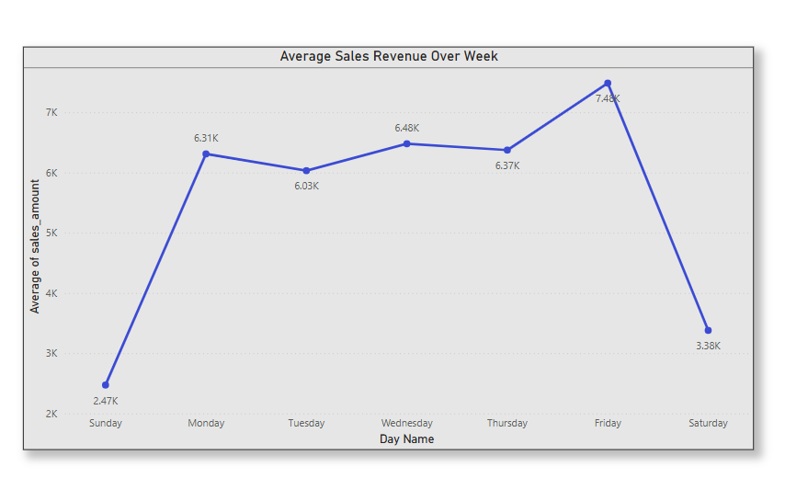
Average Sales Trends Over Week
Key Insights:
Peak Revenue Day:
Friday has the highest average sales revenue at 7.48K, indicating a strong end-of-week performance.
Lowest Revenue Day:
Sunday records the lowest average sales revenue at 2.47K, showing a significant drop at the week's start.
Midweek Stability:
Monday to Thursday show consistent revenue, ranging from 6.31K to 6.37K, with a slight dip on Tuesday.
Weekend Decline:
Saturday sees a sharp decline to 3.38K, following the peak on Friday.

Slide 7
Average Sales Trends Over Week
Recommendations:
Maximize Friday Potential:
Enhance marketing and inventory for Friday to leverage the 7.48K peak, ensuring optimal stock and targeted promotions.
Boost Sunday Activity:
Investigate factors behind the 2.47K low on Sunday and consider gentle promotions or events to increase revenue.
Maintain Midweek Consistency:
Sustain the stable 6.31K–6.37K range from Monday to Thursday with reliable service and minor incentives.
Address Saturday Drop:
Explore cautious strategies to mitigate the drop to 3.38K on Saturday, such as weekend discounts or extended hours.

Slide 8
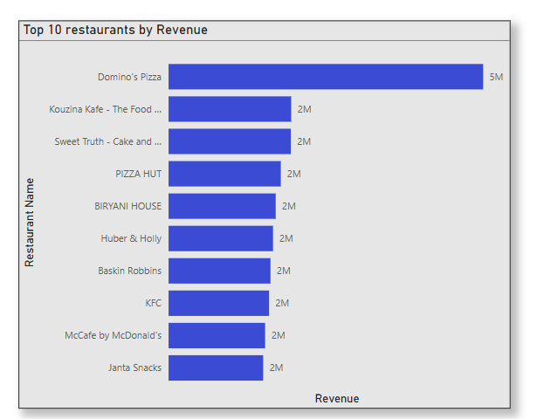
Top 10 Restaurants by Revenue Breakdown
Key Insights
Dominance of Domino’s Pizza:
With 5M in revenue, Domino’s Pizza significantly outperforms all other top restaurants, earning more than double any other competitor.
Revenue Uniformity:
The remaining nine restaurants each generate 2M, indicating a highly competitive and saturated tier below Domino’s.
Diverse Cuisine Representation:
The top performers include international chains (KFC, McDonald’s, Domino’s), dessert brands (Baskin Robbins, Huber & Holly), and local favorites (Biryani House, Janta Snacks), suggesting varied customer preferences.
Brand Strength Matters:
Well-known global brands dominate the chart, highlighting the importance of brand recognition and consistency in revenue generation.

Slide 9
Top 10 Restaurants by Revenue Breakdown
Recommendations
Leverage Domino’s Strategy:
Analyze what drives Domino’s revenue lead (e.g., delivery efficiency, pricing, promotions), and apply similar tactics to underperforming brands.
Explore Differentiation:
Since many competitors are tied at 2M, introduce unique selling propositions (USP) like exclusive menus or loyalty programs to break the tie.
Invest in Brand Marketing:
Boost visibility and engagement for non-global brands through digital campaigns, influencer marketing, and local partnerships.
Diversify Offerings:
Consider bundling meals, family packs, or premium add-ons to increase average order value in the mid-tier restaurants.
Focus on Operational Efficiency:
Optimize delivery logistics, order accuracy, and service speed to convert customer satisfaction into higher revenues.

Slide 10
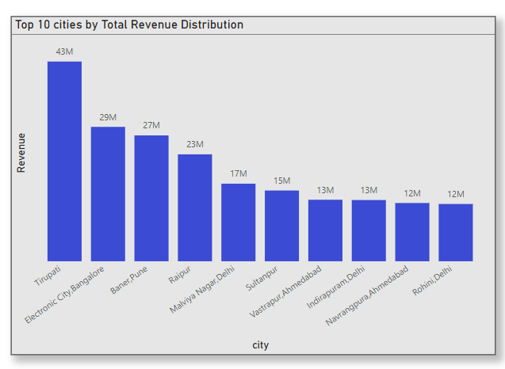
Top 10 Cities by Revenue Breakdown
Key Insights
Top Revenue Generator:
Tirupati leads with the highest revenue at 43M, significantly outperforming other cities.
Significant Drop-off:
The revenue drops sharply from 43M (Tirupati) to 29M (Electrocinity, Bangalore), indicating a concentration of revenue in the top city.
Close Competitors:
Bangalore (29M) and Pune (27M) are the next highest, showing a competitive revenue range among the top three.
Declining Trend:
Revenue decreases steadily from 23M (Raipur) downwards, with the bottom five cities (Sultanpur, Ahmedabad, Indirapuram, Navrangpura, Rohini) ranging between 15M and 12M.
Revenue Distribution:
The top three cities account for a large portion of the total revenue, suggesting an uneven distribution.

Slide 11
Top 10 Cities by Revenue Breakdown
Recommendations
Strategic Resource Allocation:
Consider directing additional investments and operational focus toward Tirupati (43M) and Electronic City, Bangalore (29M) to sustain and potentially enhance their current revenue leadership, while ensuring resources are utilized efficiently.
Targeted Development Plans:
Develop tailored growth strategies for mid-tier cities such as Pune (27M) and Raipur (23M), aiming to gradually narrow the revenue gap with top performers through careful analysis and incremental improvements.
In-Depth Market Evaluation:
Conduct a thorough investigation into the factors contributing to lower revenue in cities like Navrangpura, Ahmedabad (12M) and Rohini, Delhi (12M), addressing potential market barriers or operational inefficiencies with a cautious and data-driven approach.
Balanced Expansion Efforts:
Explore opportunities to diversify product offerings or marketing initiatives in lower-revenue cities such as Sultanpur (15M) and Indirapuram, Delhi (13M), proceeding with a measured strategy to improve overall revenue distribution without overextending resources.

Slide 12
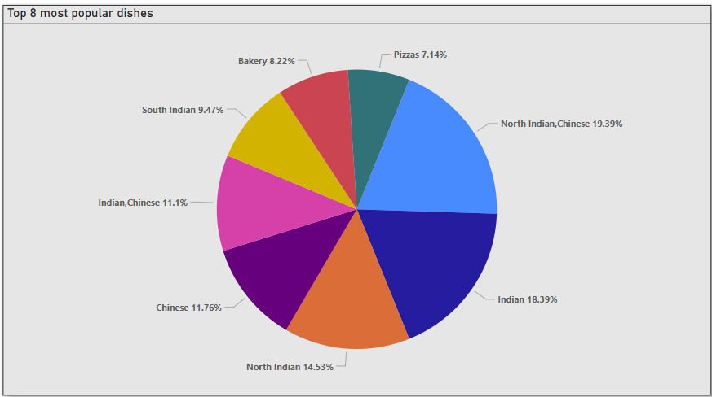
Top 8 Cuisines by Revenue Breakdown
Key Insights:
Dominant Categories:
Indian (18.39%) and North Indian/Chinese (19.39%) are the most popular dish categories, together accounting for nearly 38% of preferences.
Balanced Distribution:
South Indian (9.47%), Chinese (11.76%), Indian/Chinese (11.1%), and North Indian (14.53%) also contribute significantly, showing a diverse range of popular dishes.
Smaller Segments:
Bakery (8.22%) and Pizza (7.14%) have the smallest shares, indicating less popularity compared to other categories.

Slide 13
Top 8 Cuisine by Revenue Breakdown
Recommendations:
Focus on High-Demand Categories:
Prioritize menu development and marketing efforts on Indian and North Indian/Chinese dishes to capitalize on their strong popularity.
Enhance Mid-Tier Offerings:
Invest in improving the appeal of South Indian, Chinese, and North Indian dishes through promotions or new recipes to maintain their competitive edge.
Targeted Growth for Smaller Segments:
Explore strategies to boost the popularity of Bakery and Pizza, such as limited-time offers or unique variations, to increase their market share cautiously.
Diversified Menu Balance:
Ensure the menu remains balanced across all categories to cater to diverse customer preferences, introducing seasonal specials to test interest in underrepresented areas like Pizza.

Slide 14
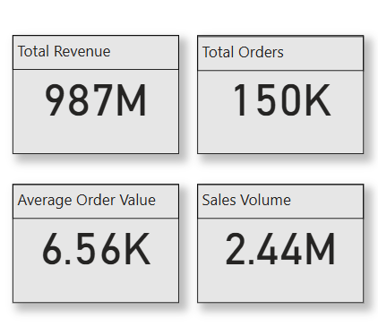
Top 4 Key Performance Indicators (KPIs)
Key Insights:
High Total Revenue:
Total revenue stands at 987M, indicating strong overall sales performance.
Significant Order Volume:
Total orders reached 150K, reflecting a robust customer base.
Moderate Average Order Value:
The average order value is 6.56K, suggesting a reasonable per-transaction revenue.
Substantial Sales Volume:
Sales volume is 2.44M, showing a considerable quantity of goods or services sold.

Slide 15
Top 4 Key Performance Indicators(KPIs)
Recommendations:
Sustain Revenue Growth:
Continue strategies that have driven the 987M total revenue, ensuring consistent customer engagement and retention.
Optimize Order Processing:
Leverage the 150K total orders to streamline operations and reduce costs, enhancing efficiency without compromising quality.
Increase Average Order Value:
Explore upselling or bundling options to cautiously increase the 6.56K average order value, improving profitability.
Boost Sales Volume:
Invest in targeted marketing to grow the 2.44M sales volume, focusing on high-demand products while maintaining a balanced approach to avoid oversaturation.

Slide 16
Conclusions
Key Revenue Drivers:
Top-performing brands such as Domino’s Pizza and Kouzina Kafe are major revenue contributors, with Domino’s leading by a significant margin.
Strategic cities like Tirupati and Electronic City, Bangalore are critical to Zomato’s revenue performance and should remain focal points for sustained growth.
Customer preferences lean heavily toward Chinese, North Indian, and Indian cuisines, with Chinese cuisine generating the highest revenue.
Seasonal Trends:
Revenue peaks in January and November, while September sees a sharp decline and December shows a slight dip, indicating clear seasonal fluctuations in demand.
Weekly Trends:
Weekday sales remain stable, but there is a notable drop in weekend sales, suggesting a shift in consumer behavior or potential operational inefficiencies.
Customer and Regional Insights:
Revenue is concentrated in specific regions, with Tirupati and Bangalore emerging as top contributors, highlighting strong regional demand and opportunities for targeted strategies.

Slide 17
Final Recommendations
Address Seasonal Fluctuations:
Investigate September Decline:
Conduct a thorough analysis of the sharp revenue drop in September ($55M) to identify root causes such as market trends, customer disengagement, or operational gaps. Implement targeted interventions like enhanced promotions or seasonal campaigns to mitigate this dip.
Boost Mid-Year Engagement:
Launch strategic marketing campaigns and promotions from April to July to counter the consistent decline observed during these months ($93M to $71M). Consider limited-time offers or loyalty incentives to maintain customer interest.
Capitalize on Q4 Momentum:
Strengthen October–November campaigns ($81M–$93M) with advanced planning, festive bundles, and optimized ad spend to maximize holiday-driven sales. Introduce loyalty perks or new-year incentives in December to minimize the post-peak drop-off ($85M).

Slide 18
Final Recommendations
Optimize Weekly Sales Patterns:
Maximize Friday Potential:
Leverage the peak revenue day (Friday, $7.48K) by enhancing marketing efforts, ensuring optimal inventory, and offering targeted promotions to capitalize on high demand.
Boost Sunday Activity:
Investigate the low revenue on Sundays ($2.47K) and introduce gentle promotions, events, or weekend-specific offers to increase engagement without overextending resources.
Address Saturday Drop:
Explore cautious strategies like weekend discounts or extended operating hours to mitigate the sharp decline in Saturday sales ($3.38K), ensuring alignment with customer preferences.

Slide 19
Final Recommendations
Leverage Top-Performing Restaurants:
Replicate Domino’s Success:
Analyze Domino’s Pizza’s strategies ($5M revenue) such as delivery efficiency, pricing models, or promotional tactics, and apply similar approaches to other brands to boost their performance.
Differentiate Mid-Tier Restaurants:
For restaurants tied at $2M revenue, introduce unique selling propositions (USPs) like exclusive menus, loyalty programs, or premium add-ons to stand out in a competitive market.
Enhance Brand Visibility:
Invest in digital campaigns, influencer marketing, and local partnerships to increase visibility for non-global brands like Biryani House and Janta Snacks, improving their market share.

Slide 20
Final Recommendations
Strategize by City Performance:
Focus on High-Performing Cities:
Allocate additional resources to Tirupati ($43M) and Electronic City, Bangalore ($29M) to sustain their revenue leadership. Optimize operations and marketing to further enhance performance.
Develop Mid-Tier Cities:
Create tailored growth strategies for cities like Pune ($27M) and Raipur ($23M) to narrow the revenue gap with top performers, using data-driven marketing and operational improvements.
Improve Lower-Revenue Cities:
Conduct in-depth market evaluations for cities like Navrangpura, Ahmedabad ($12M), and Rohini, Delhi ($12M) to address barriers. Explore diversified offerings or localized campaigns to boost revenue cautiously.

Slide 21
Final Recommendations
Capitalize on Cuisine Preferences:
Prioritize High-Demand Cuisines:
Focus menu development and marketing on Indian (18.39%) and North Indian/Chinese (19.39%) cuisines to leverage their popularity. Introduce new recipes or combos to maintain customer interest.
Enhance Mid-Tier Cuisines:
Strengthen South Indian (9.47%), Chinese (11.76%), and North Indian (14.53%) offerings through promotions or innovative dishes to sustain their competitive edge.
Boost Smaller Segments:
Increase the appeal of Bakery (8.22%) and Pizza (7.14%) through limited-time offers, unique variations, or bundled deals to grow their market share cautiously.

Slide 22
Final Recommendations
Optimize Key Performance Indicators (KPIs):
Sustain Revenue Growth:
Maintain strategies driving the $987M total revenue by focusing on customer retention and consistent engagement through loyalty programs and personalized offers.
Streamline Order Processing:
Optimize operations to handle the 150K total orders efficiently, reducing costs and improving service quality to support scalability.
Increase Average Order Value:
Introduce upselling techniques, meal bundles, or premium add-ons to cautiously increase the $6.56K average order value, enhancing profitability.
Boost Sales Volume:
Expand the 2.44M sales volume through targeted marketing of high-demand products, ensuring a balanced approach to avoid market oversaturation.

Slide 23
Final Recommendations
Plan with Forecasting and Customer Segmentation:
Align Resources with Trends:
Use historical sales data to forecast demand and align inventory, staffing, and marketing resources for operational efficiency, particularly during peak months (January, November) and days (Friday).
Targeted Customer Strategies:
Segment customers by purchase seasonality and behavior, tailoring offers to re-engage off-season buyers and maintain loyalty among frequent customers.
Thank You.

